Slide 1
Google Chromium OS: Developers’ knowledge distribution dynamics.
Samuel Mugnaini Donadelli
Concordia University
SOEN691D - Open Source Software and Mining

Slide 2
Introduction
High concentration of knowledge in ones hand reduces the quality of a software project.
It is also a vulnerable situation when this expert developer decides to quit the project, the knowledge will go will him then a knowledge gap will be installed.
Our goal is to investigate a particular OSS project to point out some causes of this negative output and a suggestion to define an approach to reduce the impact of an expert programmer leaving the project.

Slide 3

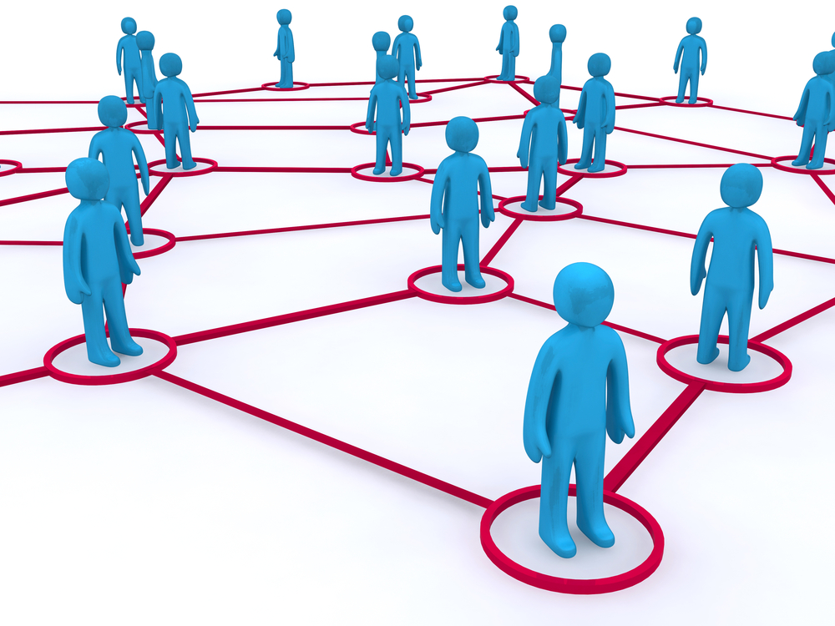
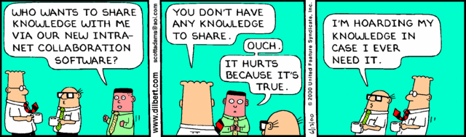
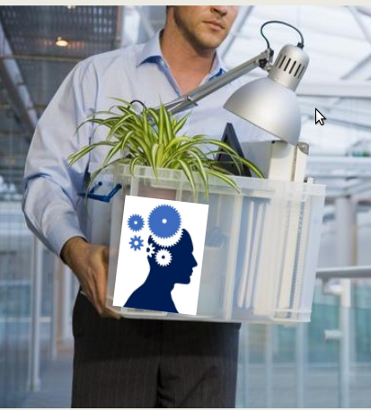
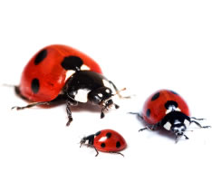



Research Questions
How shared is the code knowledge among developers?
2) How many monthly relationships does the project has?
3) Does a file with developer leavers and developer knowledge hoarders leads to buggier files?
4) Who are the possible developer candidates to take a file possession?
Notes:
RQ1 - We analysed the knowledge distribution of a file with just one developer and files with two or more developers. The reason is to obtain the current project scenario on knowledge distribution. When the file has only one developer, if this developer leaves the project it will impact in the increasing of bugs (RQ.3). On the other hand we can discover if a file would have a successor owner to handle it (RQ.4).
We also measured the know-how sharing of different types of contributors (top, major and minor) to identify the frequency rate of each type of contributor.
RQ2 - We measure pairs of developers having worked in the same file and the maximum possible value of pairs of developers each month. Because we intended to present the situation of the project regarding the current number of pairs of developers and to state the potential number of pairs of developers relationships.
RQ3 - The files defects can be related to various factors \cite{Mockus2010FSE}. A developer leaving the project and the number of developers knowledge hoarders in the project are likely to increase new defects in the files.
RQ4 - Mockus \etal~\cite{Mockus2009ICSE} described and proposed a methodology to measure the transfer of code (files succession). Based in this work we defined a simple method which one suggests who would be possible candidates to adopt "orphaned files of a single parent". The idea of "single parent" came from the event when a file has just one developer owner. Consequently if this developer leaves the project this file will be orphaned. Therefore we proposed this potential adopting "stepfather/mother" list.

Slide 4



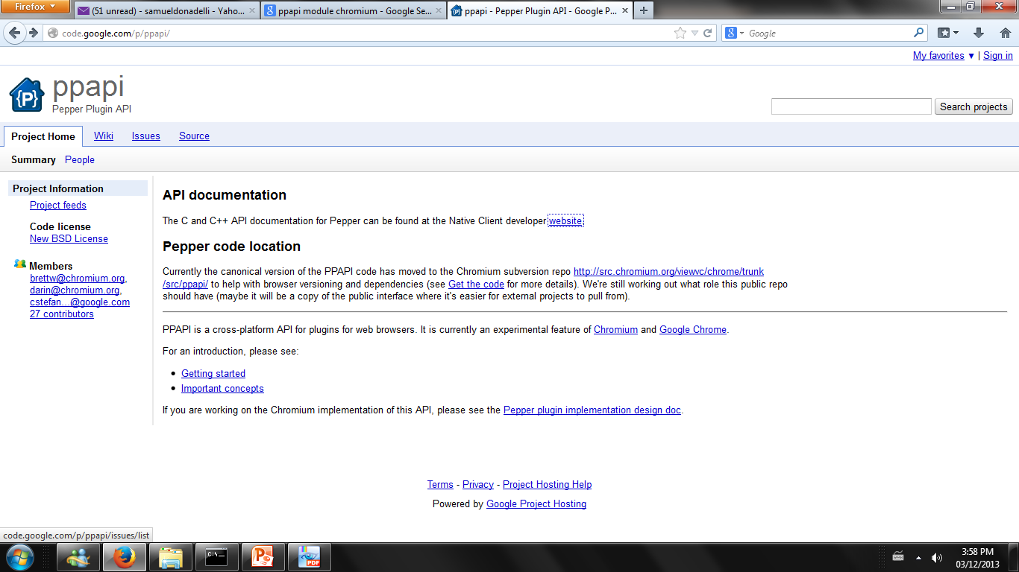
Data
Notes:
Our research questions consists basically of quantitative measures. In order to answer our key questions we retrieved specific information available into the Google Chromium archival database which one has history since July 2008 available in their website. OSS developers and users tend to use mailing lists, repositories and bug databases to establish communication, perform commits and report bugs respectively. As said OSS usually has the same fashion of archiving data worldwide, thus it facilitates the reproduction approach to any other OSS project. (Scripts and specifications on how this data was mined is accessible from the authors upon request).
The historical databases used were:
\\\\ Git Distributed Version Control archive (DVS). Once a developer is ready to apply his changes he just add the updated files and then submit them, finally pushing these changes into the code review repository in the form of patch set. After all the needed patch sets regrouped in the specific code review the "robot" will take this collection of patch sets and submitted to the system. This action will generate a commit identification code. Inside the body of a commit it will have key informations that we needed: the commit ID, the author's e-mail, the committer's date and the path (a.k.a. files). We started to mining the data from 2008 until May 2013, with total number of commits around 190000. In order to use the author e-mail as our developer identifier we extracted its user login.
\\\\ Bug database (reports submitted online). The process of opening a bug in Google Chromium project can be done by everyone without any restrictions. The bugs list can be found in the Google Chromium website. Its template includes a summary, a briefly description of the bug, the attachment if needed and the submitter must be signed in. The total number of bugs were close to 47000 from 2008 until May 2013. We used this sampling in our investigation. A Python script was used to extract the bug code and the involved paths.
\\\\ It is important to notice that the steps used to track using identification codes of: commit, code review and bugs was: first the code review web address has a code review id (which one has been parsed) and in its body has a bug id, second in the commits body message there is the code review id which one can be linked with the code review ID (the parsed one), third with the bug id is possible to keep track of bugs using the index of bugs database. Finally with all these information it was possible to have a table with: developer, commit date, file, bugs.
\\\\ The data mined from Chromium project was used for us in order to build our criteria to select the specific modules we would like to work with, besides of our developer knowledge analysis.

Slide 5
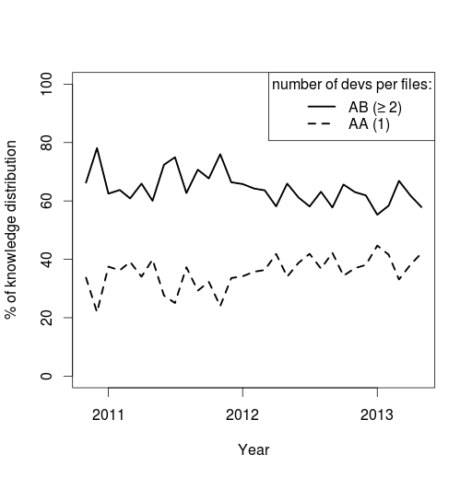
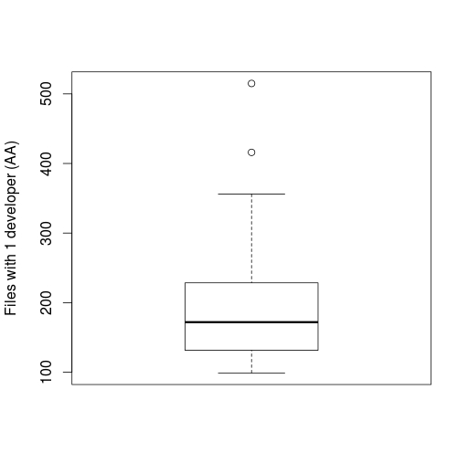
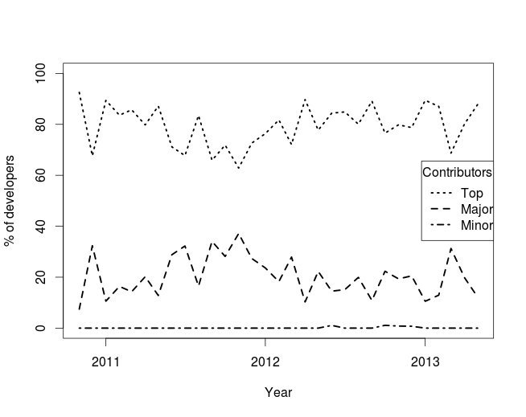
R.Q.1) How shared is the code knowledge among developers?
Notes:
\\\\We need the code ownership for each file in the module PPAPI in a monthly basis. For each of the files we will calculate the number of commits each author made, then the total of commits in that particular file, then divide one by the other to obtain the individual contribution rate.
\\\\In order to obtain the knowledge distribution per month, we verified if the files had 1 or more developers per month which one is represented in the Figure ~\ref{fig:Monthly know-how PPAPI}. Based on this chart we wanted to know how many files with just 1 developer we had per month represented in Figure ~\ref{fig:Monthly file of single parent distribution}.
\\\\Using the definition given by Bird \cite{Bird2011ESEC} top developer (40\% or more), major developer (between 5\% and 40\%) and minor (less than 5\%) we classified the developers per their monthly individual contribution rate in code ownership table.
\\\\
\textit{R.Q.1-Results and Discussion}
We analyse the knowledge distribution of a file with just one developer and files with two or more developers. The reason is to obtain the current project scenario on knowledge distribution if the file with one developer, in the case this developer leaves the project it may impact in the increasing of bugs (RQ.3). On the other hand we can discover if a file would have a successor developer to handle it (RQ.4).
We also measured the know-how sharing of different types of contributors (top, major and minor) to identify the frequency rate of each type of contributor. .
\begin{figure}
\includegraphics[width=\imageWidth]{Charts/RQ1chart1.jpeg}
\caption{Knowledge distribution per month in Google Chrome Module PPAPI}
\label{fig:Monthly know-how PPAPI}
\end{figure}
\\\\In Figure~\ref{fig:Monthly know-how PPAPI} X axis represents the period in months (total of 25 months) and the Y axis represents the knowledge distribution rates (shared and individual). The median for shared knowledge into module PPAPI in Google Chromium was 64\% and the individual knowledge was 36\%. Complementary we can see in Figure ~\ref{fig:Monthly file of single parent distribution} presents a median of 172 files with only 1 developer per month. The fact of having 36\% of individual knowledge concentrated in ones hand is a worrying scenario. Once a person leaves a project if nobody else knows about that part of code owned by the leaver developer the project will start becoming a secret and in a future it might encounter a deadlock. This rate is not a calculation of Truck Factor as implied in some of these papers\cite{Zazworka2010ESEM,Ricca2011PROFES,Torchiano2011Wetsom} , but instead it assists the idea of when knowledge is not shared this means potential issues to the project in loosing a key developer member. Offering support to this idea the number of relationships a developer had per month will be discussed in RQ. 2
\\\\Figure ~\ref{fig:Knowledge sharing among contributors per month} represents the total contribution per different classes of developers medians are: top 80\%, major 19\% and minor 1\% of total commits per month respectively. As we can see 80\% are top developers (greater than 40\% of file ownership), though the leaver is likely to be a top developer. We will discuss if developer with high concentration of individual knowledge and a developer leaves the project impacts increasing the number of defects on RQ.3. At the same time we will suggest a list of possible successor candidates to "orphaned files of a single parent" on RQ.4.
\begin{figure}
\includegraphics[width=\imageWidth]{Charts/RQ1chart2.jpeg}
\caption{Files with 1 developer per month}
\label{fig:Monthly file of single parent distribution}
\end{figure}
\begin{figure}
\centering
\includegraphics[width=\textwidth,height=10cm]{Charts/RQ1chart3.jpeg}
\caption{Knowledge distribution among types of contributors in Google Chrome Module PPAPI}
\label{fig:Knowledge sharing among contributors per month}
\end{figure}

Slide 6
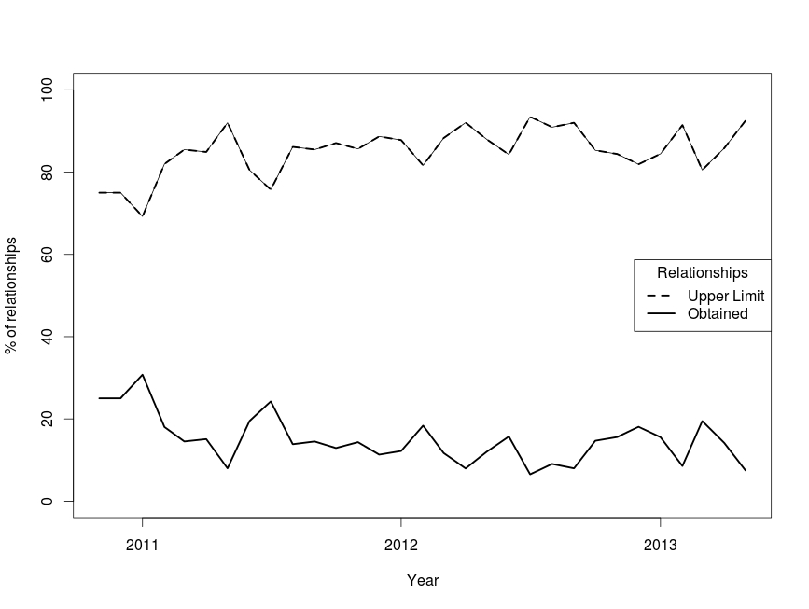
R.Q.2) How many monthly relationships does the project has?
Notes:
subsection{R.Q.2) How many monthly relationships does the project has?}
\\\\
\textit{R.Q.2-Methodology}
\\\\Brooks Law implies that add more man to a project lengthens, not shortens, the schedule.
\\\\On the contrary we still need developers with knowledge shared to avoid a code become unknown and obscure. Besides our goal is to provide a way which one can assist software project responsible to visualise which parts of the system are susceptible to become "orphaned" and no one else will know about them. Hence we adopted Brooks "group intercommunication formula"~\ref{fig:Group intercommunication formula} and its result will represent our upper limit of relationships per month.
The pairs of developers obtained per month was calculated using a script which one counted the set of common files between two developers.
\\\\
\textit{R.Q.2-Results and Discussion}
\\\\ In Figure~\ref{fig:Rel Mod PPAPI} we can see that the upper limit of relationships per month would be 276 and the total obtained from historical data is 46 per month, which results in 15\% of relationships currently happening per month. This suggests that few developers are working in pairs. The obtained relationships per month is lower compared to the upper limit relationships per month. Therefore we can imply that in this specific case a small number of knowledge is being shared among developers (knowledge hoarders).
\begin{figure}
\centering
\includegraphics[width=\textwidth,height=10cm]{Charts/RQ2chart1.jpeg}
\caption{Number of developers relationships in Google Chrome Module PPAPI}
\label{fig:Rel Mod PPAPI}
\end{figure}

Slide 7
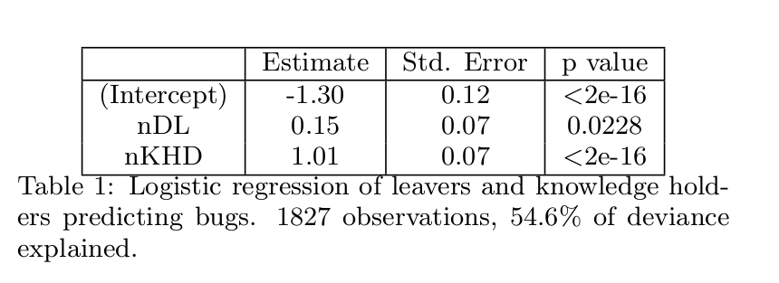
R.Q.3) Does a file with leavers developers and knowledge hoarders developers leads to buggier files?
Notes:
subsection{R.Q.3) Does a file with developer leavers and developer knowledge hoarders leads to buggier files?}
\\\\
\textit{R.Q.3-Methodology}
\\\\ The impact of people leaving software projects have been studied in several papers. Understanding how programmers leaving would impact the quality of code generating more bugs was studied by Mockus \cite{Mockus2010FSE} and replicated by himself in a paper which one he discovered that 60\% of customer failures defects stands for the top 1\% of code \cite{Mockus2013FSE}. This can be explained by the total number of leavers developers and past changes. For open source project Robles et al. \cite{Robles2009HICSS} described developers leavers as the one with no commits during a period in the past. We will use this definition and we set up the period as being no commits for more than six months. The approach used to extracted the leaver developers was first to take the last date of our mined data May, 2013, second we considered that when the author maximum date was less November, 2012, as a result we will have our leaver developers.
\\\\Cataldo \etal~\cite{Cataldo2006CSCW} proposed the coordination requirement method which one shows the distribution of how much knowledge developer A "should know about" developer's B job. The coordination requirements calculation is represented by the equation~\ref{fig:Coordination Requirements equation}. Our need is different we want to know the current situation of developers knowledge about each other tasks. Though we will not use the files dependencies (Files/Files) in the matrices multiplication because it stands for the "should know about" (likelihood) instead of obtaining the real scenario. Hence our matrix calculation will be:
\begin{equation}
{(Devs / Files)}*{(Devs / Files)}^{-1}
\label{fig:Devs per devs matrix}
\end{equation}
\\\\The resultant table will represent the magnitude of knowledge by pairs of developers. For instance the knowledge author A has about author B work and the individual knowledge author A has about his own work. The idea we have is to consider pair AA value (individual) and sum all the values of distinct pair AB, AC, AD separately (shared knowledge). In order to get this results we run a script which one calculates the total knowledge for pairs shared knowledge (AB) and individual (AA) respectively. In the case the number of individual knowledge was greater than the shared knowledge we considered the developer as being a knowledge hoarder.
\\\\ Another important item we must have is the total number of bugs per files which one was obtained with the mined data from the bug database.
\\\\
\textit{R.Q.3- Results and Discussion}
\\\\ We present in this section the result of logistic regression model representing an individual file, correspondent bugs and the predictors including two elements being associated with bugs: developer leavers and developers knowledge hoarders. As already clarified in RQ1 the majority of developers (80\%) are top developers. With this in mind we believe a project expert leaving the project and information being held in few developers hands will increase the rate of defective files in a system. Hence our model is: total of developers leavers nDL - 1 and the presence of knowledge hoarders developers nKHD - 1. The logistic regression is presented on table 1.
\begin{table}
\centering
\caption{Logistic regression of leavers and knowledge holders predicting bugs. 1827 observations, 54.6\% of deviance explained.
}
\begin{tabular}{|c|c|c|c|} \hline
& Estimate & Std. Error & p value \\
\hline
(Intercept) &-1.30 & 0.12 &<2e-16\\
nDL &0.15 &0.07 &0.0228 \\
nKHD &1.01 &0.07 &<2e-16\\
\hline
\end{tabular}
\end{table}
Then we can trace the following model for Google Chromium PPAPI module organizing by candidate defective files:
0.15 ln nDL + 1.01 ln nKDH
Based on the results found on table 1 we can infer that leaver developers and knowledge hoarder developers are collaborative factors which ones relates to the increasing rate in the number of bugs.
The bug predictor is strongly correlated to developers leavers and knowledge hoarders making this equation model to fit our needs. In order to avoid knowledge hoarder leaving your project and creating a gap in its comprehension it is important to have a backup plan. For this reason we proposed the RQ.4. In this question we studied a method for suggesting possible candidates to fill in the gaps left behind by those leavers developers.

Slide 8
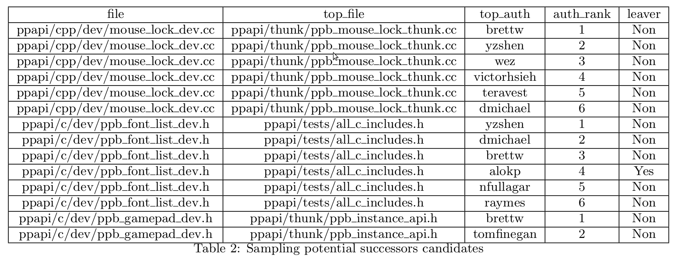
R.Q.4) Who are the possible developer candidates to take a file possession?
Yes
Yes
Yes
Yes
Notes:
- 1.50 min: Answer to RQ 4 (methodology, results and discussion)
\subsection{R.Q.4) Who are the possible developer candidates to take a file possession?}
\\\\
\textit{R.Q.4-Methodology}
\\\\ First we defined our sampling target which would be the files with 1 developer corresponds to 350 files out of 1827, or 20\% of the total files are files of single developer (files of single parent). This is our range because if the "parent" leaves the file behind, it will be orphaned, then we want to know potential stepfathers/mothers to take this file possession. Second we start using Cataldo\cite{Cataldo2006CSCW} method "files dependencies" in which we are able to identify files that most correlates with our file of a single parent. Third we use the table task assignments (developer per developer) to obtain the rank of authors with greatest code ownership for that particular file. We aimed to extract the top 6 code owners comprehends 80\% of all potential successors as shown in figure~\ref{fig:Choice justification by authors ranking} .
Finally to be sure the developer was active in the project we used the leavers definition (6 months without any commit equals developer leaver/non-active, active otherwise).
\textit{R.Q.4-Results and Discussion}
\\\\ Table ~\ref{tab:Sampling potential successors candidates} presents a sampling of the results of potential successors in the case a developer leaves the project and the file could be possessed by these candidates. Ideally the best candidate is top 1 code owner, then top 2 and so on.
From 350 files with only one developer each one, 231 had possible successors which means 66\% of potential files orphans of single parents would have the possibility to find a stepfather/mother. Figure~\ref{fig:Potential ranking devs successors} represents the number of possible successors per rank.
\\\\The importance of this approach is due to the clarification of each files are in danger to become obscure, in our particular case 34\% has a risk of no succession resulting in a lack of knowledge. Hence the project responsible can use this method as a preventive tool and define action plans to avoid this situation.
\begin{figure}[H]
\includegraphics[width=\imageWidth]{Charts/RQ4chart1.jpeg}
\caption{Choice justification by authors ranking}
\label{fig:Choice justification by authors ranking}
\end{figure}
\begin{figure}[H]
\includegraphics[width=\imageWidth]{Charts/RQ4chart2.jpeg}
\caption{Potential number developers successors per their ranking}
\label{fig:Potential ranking devs successors}
\end{figure}
\begin{table*}[t]
\centering
\caption{Sampling potential successors candidates}
\label{tab:Sampling potential successors candidates}
\begin{tabular}{|c|c|c|c|c|} \hline
file & top\_file & top\_auth & auth\_rank & leaver \\ \hline
ppapi/cpp/dev/mouse\_lock\_dev.cc & ppapi/thunk/ppb\_mouse\_lock\_thunk.cc & brettw & 1 & Non \\ \hline
ppapi/cpp/dev/mouse\_lock\_dev.cc & ppapi/thunk/ppb\_mouse\_lock\_thunk.cc & yzshen & 2 & Non \\ \hline
ppapi/cpp/dev/mouse\_lock\_dev.cc & ppapi/thunk/ppb\_mouse\_lock\_thunk.cc & wez & 3 & Non \\ \hline
ppapi/cpp/dev/mouse\_lock\_dev.cc & ppapi/thunk/ppb\_mouse\_lock\_thunk.cc & victorhsieh & 4 & Non \\ \hline
ppapi/cpp/dev/mouse\_lock\_dev.cc & ppapi/thunk/ppb\_mouse\_lock\_thunk.cc & teravest & 5 & Non \\ \hline
ppapi/cpp/dev/mouse\_lock\_dev.cc & ppapi/thunk/ppb\_mouse\_lock\_thunk.cc & dmichael & 6 & Non \\ \hline
ppapi/c/dev/ppb\_font\_list\_dev.h & ppapi/tests/all\_c\_includes.h & yzshen & 1 & Non \\ \hline
ppapi/c/dev/ppb\_font\_list\_dev.h & ppapi/tests/all\_c\_includes.h & dmichael & 2 & Non \\ \hline
ppapi/c/dev/ppb\_font\_list\_dev.h & ppapi/tests/all\_c\_includes.h & brettw & 3 & Non \\ \hline
ppapi/c/dev/ppb\_font\_list\_dev.h & ppapi/tests/all\_c\_includes.h & alokp & 4 & Yes \\ \hline
ppapi/c/dev/ppb\_font\_list\_dev.h & ppapi/tests/all\_c\_includes.h & nfullagar & 5 & Non \\ \hline
ppapi/c/dev/ppb\_font\_list\_dev.h & ppapi/tests/all\_c\_includes.h & raymes & 6 & Non \\ \hline
ppapi/c/dev/ppb\_gamepad\_dev.h & ppapi/thunk/ppb\_instance\_api.h & brettw & 1 & Non \\ \hline
ppapi/c/dev/ppb\_gamepad\_dev.h & ppapi/thunk/ppb\_instance\_api.h & tomfinegan & 2 & Non \\ \hline
\end{tabular}
\end{table*}

Slide 9
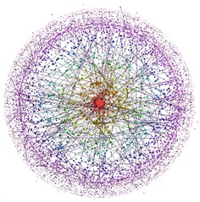
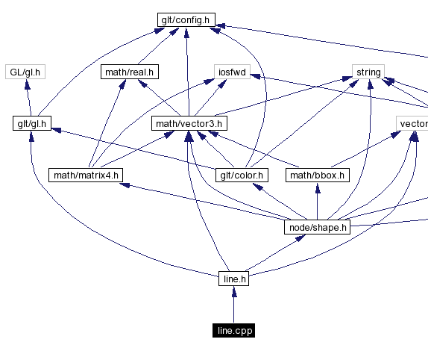

Validity
Task Dependencies table
Files\Files | A | B | C | D | E
A | - | 4 | 44 | 13 | 32
B | 4 | - | 25 | 43 | 5
C | 44 | 25 | - | 41 | 7
D | 13 | 43 | 41 | - | 16
E | 32 | 5 | 7 | 16 | -
Notes:
\section{Threats to Validity}
\\\\As our study has been performed in a Open Source Project where the source code, reviews and bug databases are freely available to the public a external credibility must be discussed.
This study was done in a module set of Google Chromium OSS project which has its limitations because it is partial system.
In order to enhance the generalization of our research, a pre-test was done in a old Apache database from 1996 to 2005 with less developers and source files respectively and the methodology, scripts and queries was satisfactory.
\\\\Task dependencies matrices are hard to be done in large software projects. Our extraction was performed in three days running a script given the Google Chromium OSS module PPAPI numbers: 1827 files, 198 developers and 2165 commits. Other papers also studied coordination requirements and they performed the matrices calculation. Cataldo \cite{Cataldo2006CSCW} used a project sampling with 809 commits. Costa\etal~\cite{Costa2011CHI} used five project samplings ranging from 3078 to 66650 commits. As we can see these two researches matrices calculation were made in small to medium size software projects. Hence the modelling algorithm might be difficult to run in larger projects. We experienced a difficult situation when running matrices calculation scripts in the whole Google Chromium OSS project which one is a large project with more than 150K commits over four years of historical data.
\\\\The definition of leavers can vary from one specific scenario to another. Depending on the years of historical data we might have to adapt the developers leavers definition to each specific situation to be able to answer research question number 3.
\\\\There are other factors to explain defects prediction as number of changes in a file, complexity, files dependencies, size, developers expertise and so on. Our goal in this research is not to re-state the co-factors of bugs already studied in other researches \cite{Mockus2013FSE}, on the contrary our research goal was specifically to verify the relation between defects, developers knowledge hoarders and leavers. Then our model composed by both prediction variables (leavers and knowledge hoarders) fitted in our research question 3.
\\\\Research question 4 treated the potential successors for files with only one developer. However this methodology is not just limited to these files. Every file can have their own list of potential successors, though this method is extensible to the whole project.
\\\\Google Chromium is a large project focused on creating and improving web applications with high security to users. Moreover this project has thousand of developers contributing. Hence any other software project with historical data from a source code repository: source files, the developers who changed those files, dates will be able to replicate the approach presented here.

Slide 10
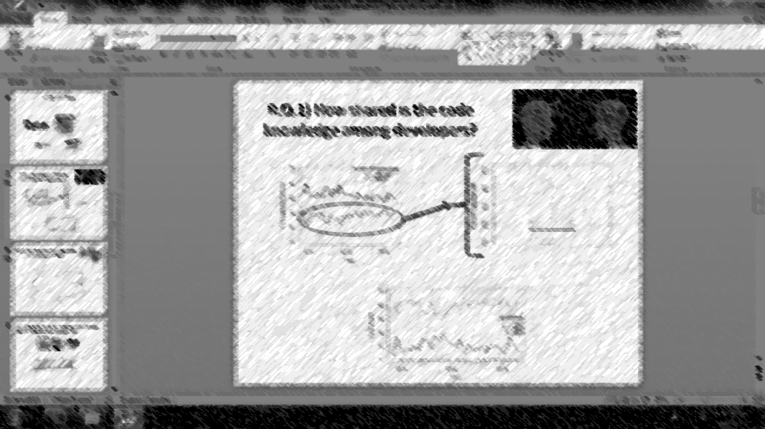
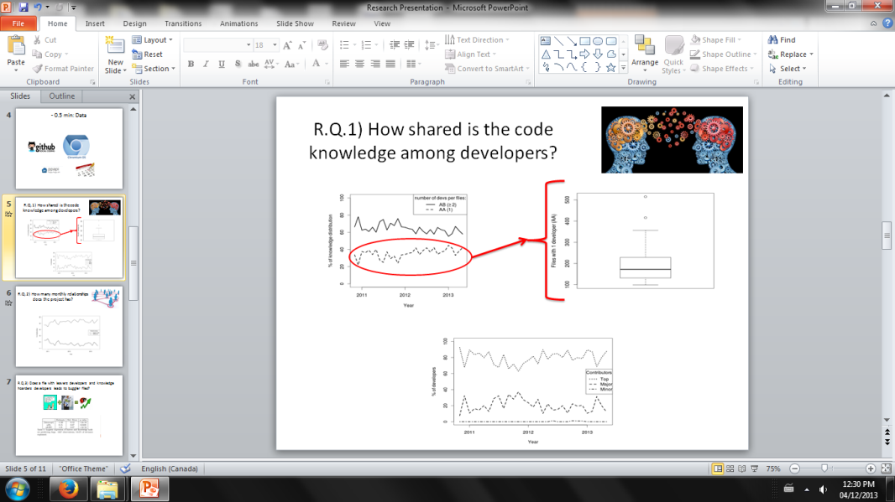
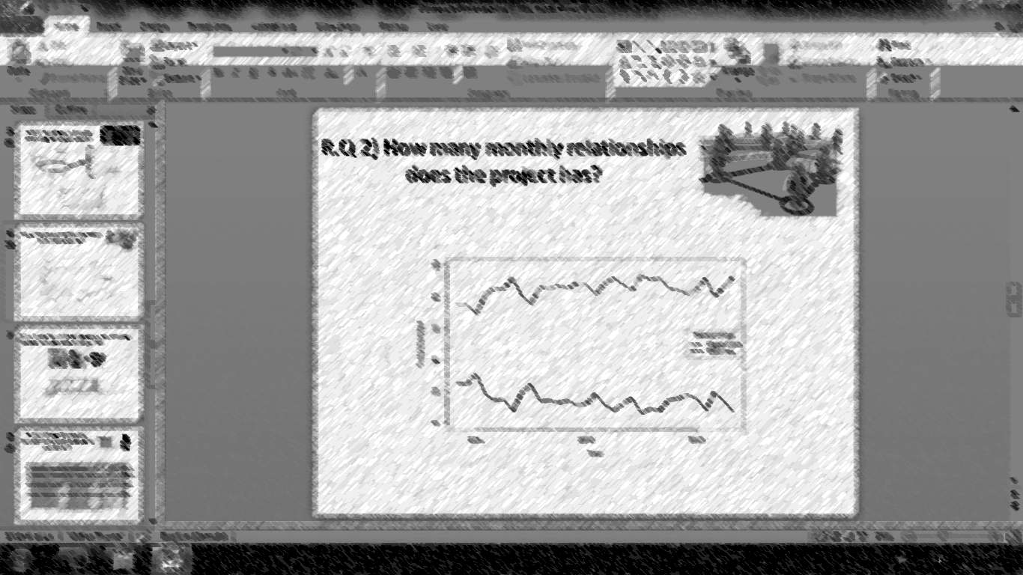
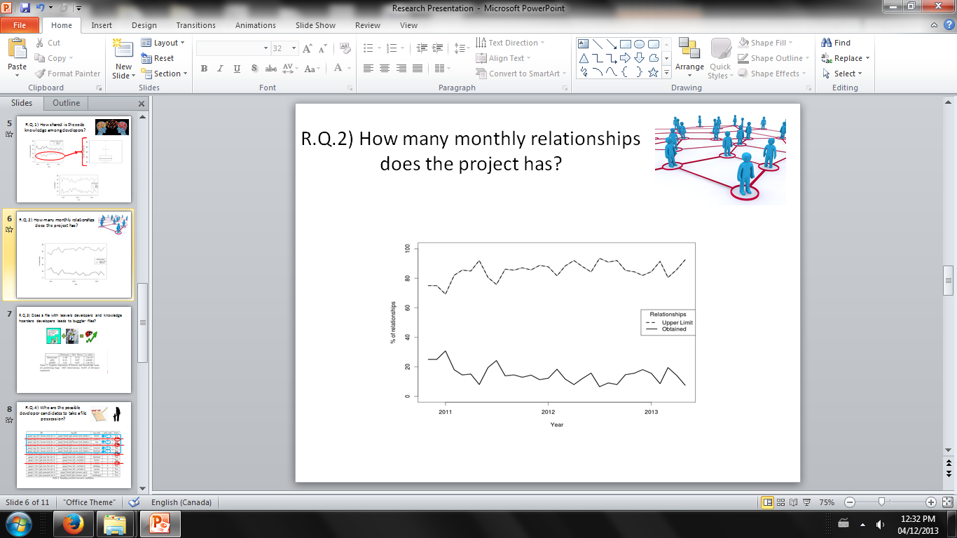
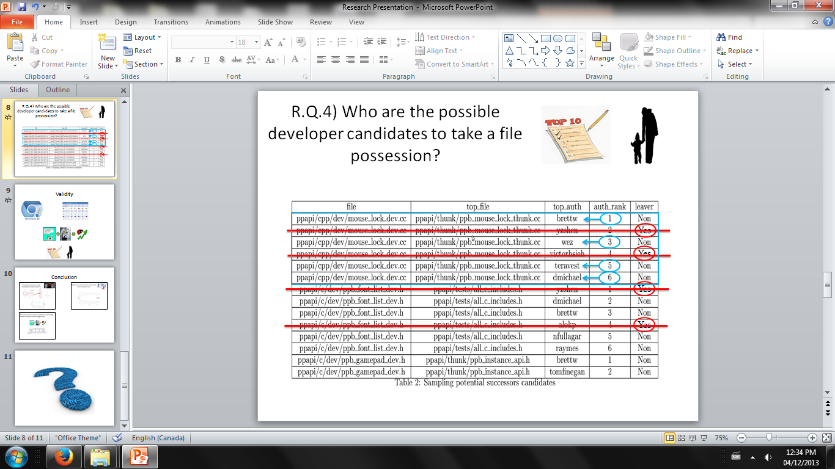
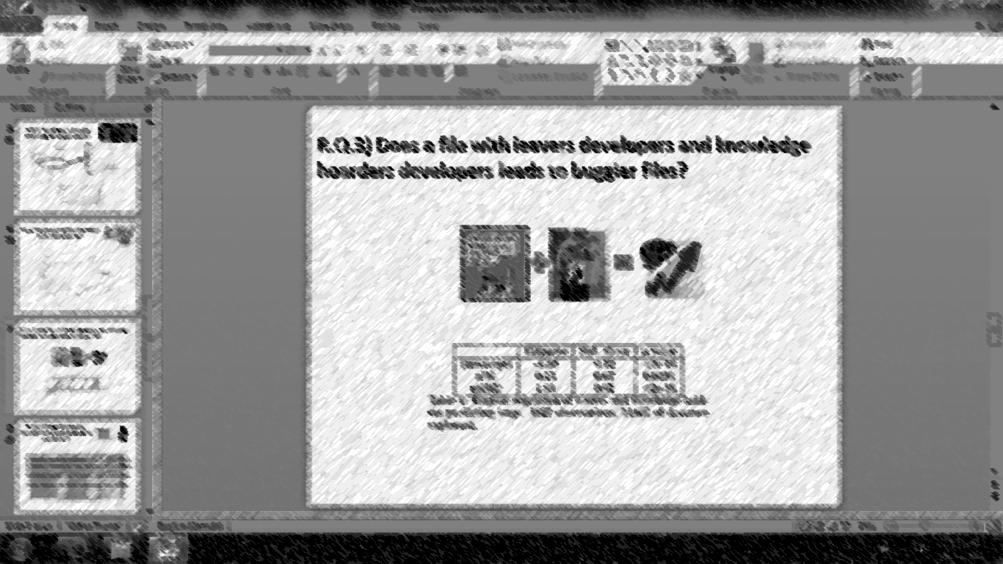
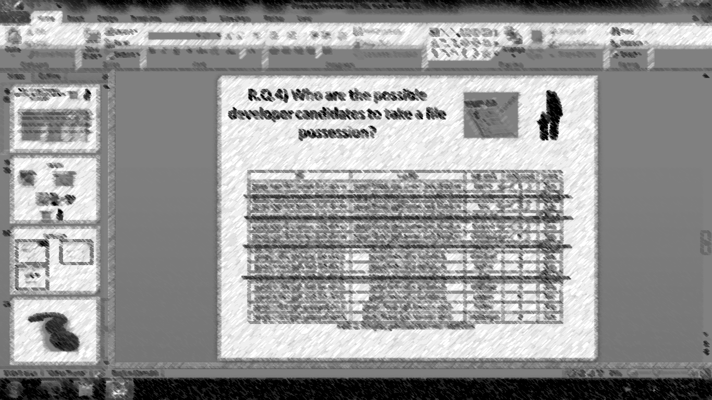
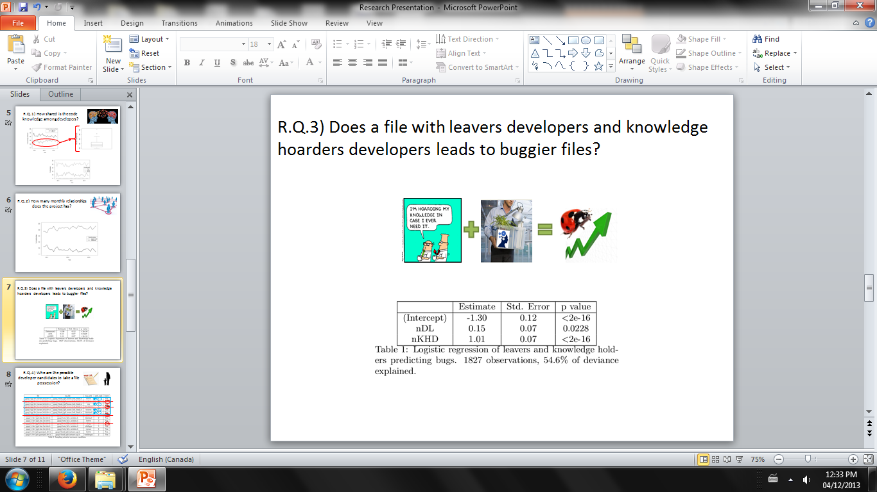

Conclusion
Knowledge:
Shared 64%
Indiv. = 36%.
Number of relationships per month around 15% of total capacity...
Developers:
Top 80%
Major 19% Minor 1%
Notes:
\section{Conclusion}
\\\\The evidences demonstrated that this project is at a high risk on loosing a developer with ample knowledge concentration in its own hands. Its impact can have great proportion creating a "black hole" in the project comprehension. Other developers will carry the heavy investigation load of that specific part of the code to acquire its logical comprehension. Hence most part of their time will not be used to develop new source code, instead it will be to decipher this neglected part of the system.
\\\\Most part of the project knowledge is kept individually with each developer and it is not being shared as it could be. From R.Q.2 we presented that the pair relation between developers per month is low. Moreover the developers are not considering their full potential of knowledge sharing with other developers. They are using 15\% of their relationship capacity.
\\\\The knowledge hoarders and leavers are collaborators on increasing the bug rates.
In order to reduce the impact of knowledge hoarders and leavers in the project we proposed the potential successors candidates list to take possession of files orphaned of single parents. Besides it may serve as a tool to software managers to discover who is capable of taking possession of those files, reducing its negative impact. This work reports the findings of this particular software project study case and it can serve as a reference to be applied in OSS studies and in private software companies.
\\\\As shown in this case study our goal is to motivate OSS developers and software project leaders to start sharing more knowledge, because this makes a great difference when comes the time as soon as a developer leaves the project. The team will not carry this burden of lack of know-how. They will have enough expertise to handle it and ensure continuity of your project without compromising its quality and productivity.

Slide 11


